Slide 1
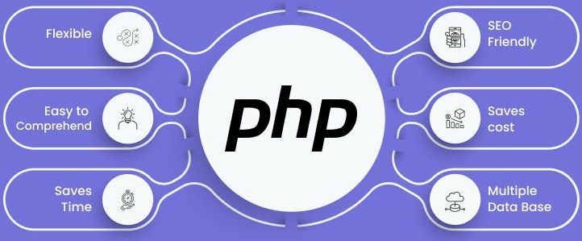

Slide 2
About today…
Introduction to PHP
Environment setup

Slide 3


Slide 4
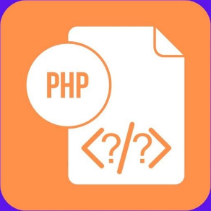
What is PHP?
PHP stands for “PHP Hypertext Preprocessor"
Server-side scripting language designed for web development
Embedded within HTML to create dynamic web pages

Slide 5
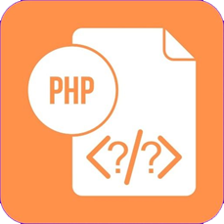
History of PHP
Created by Rasmus Lerdorf in 1994
Originally stood for "Personal Home Page"
Evolved into a powerful tool for making dynamic and interactive web pages

Slide 6


Key Features
Open-source and free to use
Cross-platform compatibility (works on Windows, Linux, macOS)
Supports a wide range of databases (MySQL, PostgreSQL, SQLite)
Extensive library of built-in functions
Excellent community support and documentation

Slide 7



Common Uses
Creating and managing content management systems
Building e-commerce platforms
Developing web applications and RESTful APIs
Generating dynamic web content

Slide 8
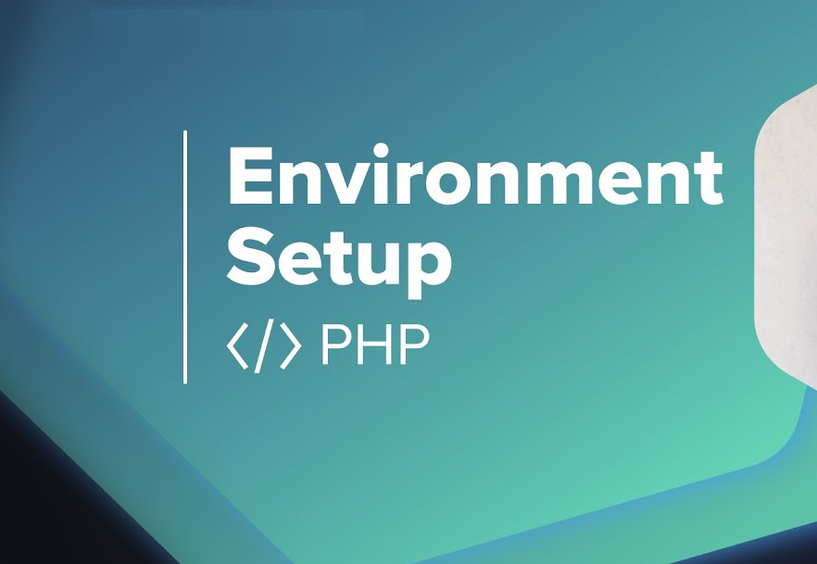

Slide 9
Download and Install WampServer
Go to the WampServer website and download the latest version of WampServer suitable for your Windows system (32-bit or 64-bit)
( https://mythemeshop.com/blog/installing-wamp-server/ )
Run the WampServer installer that you downloaded
Follow the on-screen instructions to install WampServer on your system
Choose the installation directory (e.g., C:\wamp) and click "Next" to proceed
Once installed, launch WampServer from the Start menu
or desktop shortcut.

Slide 10

Start WampServer Services
After launching WampServer, you'll see its icon in the system tray (near the clock)
Left-click on the WampServer icon, then click on "Start All Services" to start the Apache web server, MySQL database server, and PHP
Open your web browser and enter http://localhost/ in the address bar.
You should see the WampServer homepage indicating that WampServer is installed and running correctly

Slide 11

Access phpMyAdmin
To access phpMyAdmin for managing MySQL databases, click on the WampServer icon in the system tray, then navigate to phpMyAdmin under the "Tools" menu
Alternatively, you can access phpMyAdmin directly by entering http://localhost/phpmyadmin/ in your web browser.

Slide 12
Start Developing
You're now ready to start developing web applications using WampServer
Place your project files in the www directory within the WampServer installation directory (e.g., C:\wamp\www)
Access your projects through the browser using http://localhost/your_project_folder

Slide 13
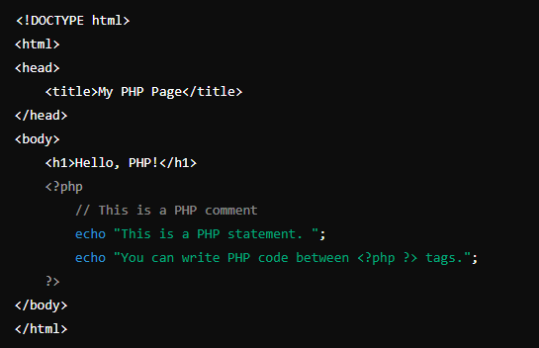
Creating first php file
Create a file named “index.php” in “C:\wamp\www\project”

Slide 14
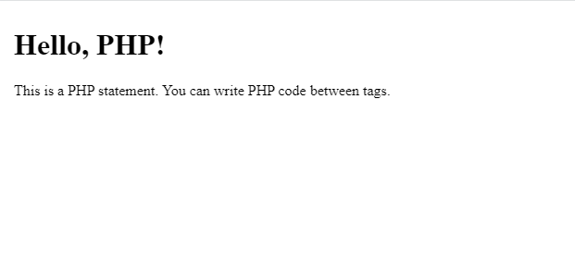
Preview webpage
Open your web browser and enter the following URL in the address bar: http://localhost/project/

